Slide 1

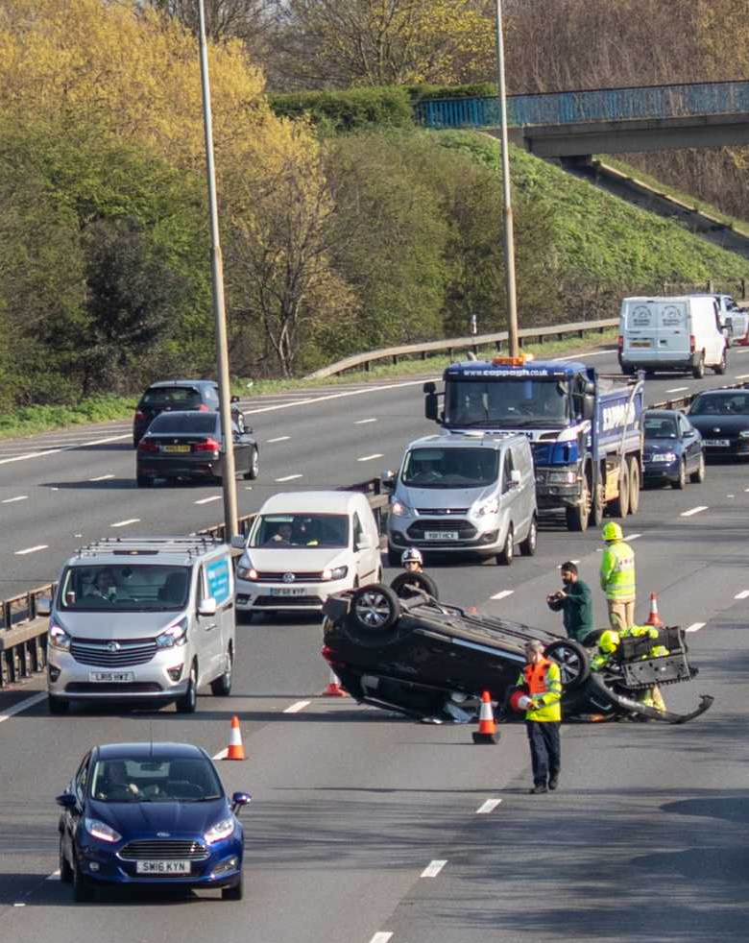
Accidents in UK
-Susmitha Rudraraju

Slide 2
Content
Overview
Steps performed for analysis
Data Source
Data Pre-Processing
Data Visualization
Machine Learning Algorithms
Conclusion

Slide 3
Overview
Road accidents have been a major concern for all the countries around the world. This will result in death and injuries of many people.
Using data science techniques could be helpful in identifying the major reasons for occurrence of accidents and help in resolving the problems.
Analyze the data, plot various Data Visualization graphs and implement different Machine Learning algorithms and finally evaluate the model that gives better accuracy in predicting the accidents severity which will help the police department to identify the reasons for accidents to take place and take necessary actions to provide safety of the people.

Slide 4
Steps performed for analysis
Data Collection from source
Data Pre-processing
Data Visualization
Data Modeling
Evaluation of the results

Slide 5
Data Source
Data was collected from government website of UK
https://data.gov.uk/dataset/cb7ae6f0-4be6-4935-9277-47e5ce24a11f/road-safety-data
Used the data from 2016-2020 CSV files.
Used three CSV files that was published on 14th October 2021:
Road Safety - Accidents last 5 years
Road Safety - Vehicles last 5 years
Road Safety - Casualties last 5 years
'Road Safety Open Dataset Data Guide.xlsx’ is a supporting guide file which has details on Codes and Formats present in the csv files

Slide 6

Data Pre-Processing
Merged all the three CSV files into single data frame using a common column
After merging the dataframe has 1229471 rows and 79 columns
Removed Null values
Changed few datatypes
Changed few numeric values to categorical values
Removed few unnecessary columns

Slide 7

Data Visualization

Slide 8
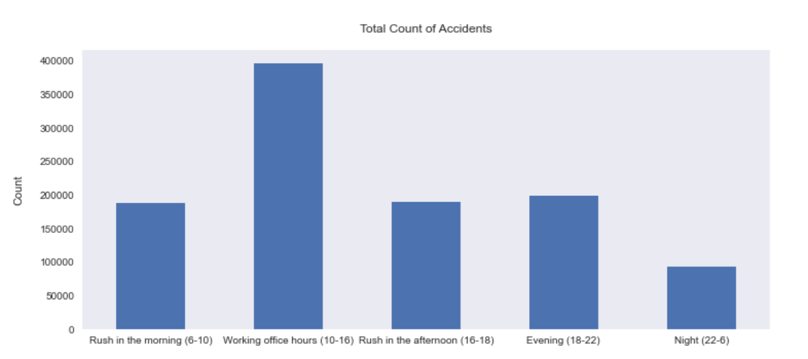
Around what time of the day do accidents occur the most?
Working Office hours from 10am to 4pm is the highest
Least is during the Night.

Slide 9
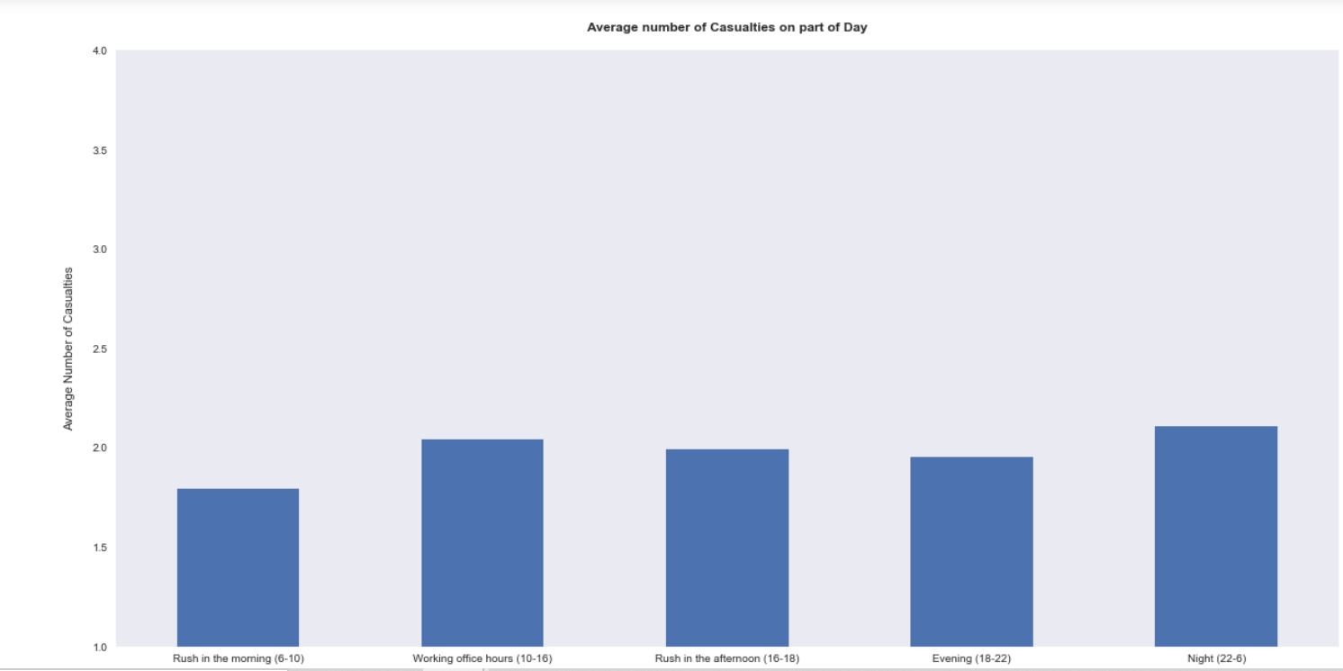
Average Number of Causalities based on part of a Day
Highest during Night from 10pm to 6pm
Least is during Rush in the Morning from 6am to 10pm

Slide 10
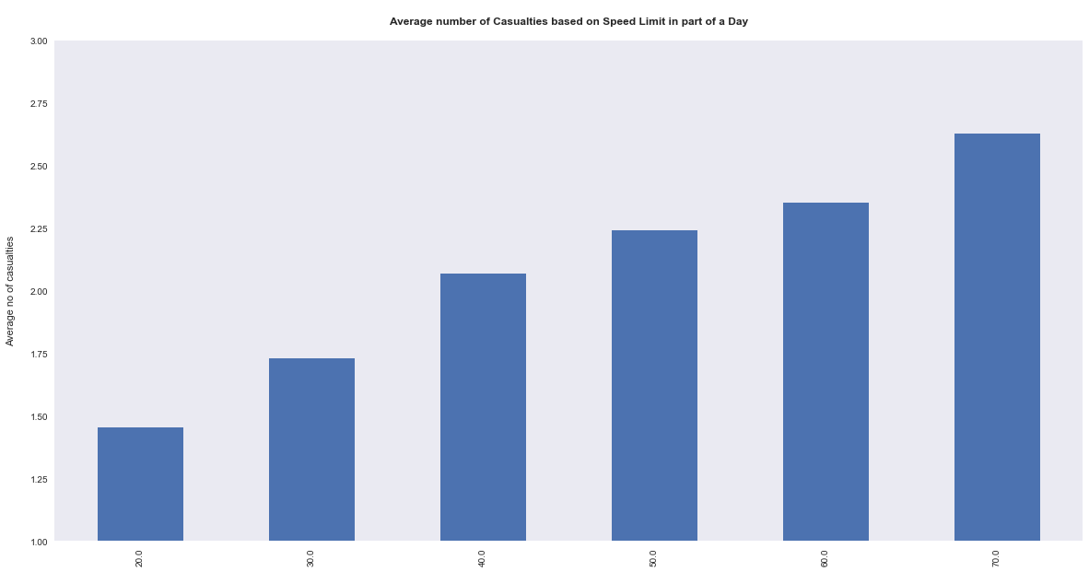
Average Number of Casualties based on Speed Limit in part of a day
Speeding caused accidents. Highest speed was 70mph which caused accidents.

Slide 11
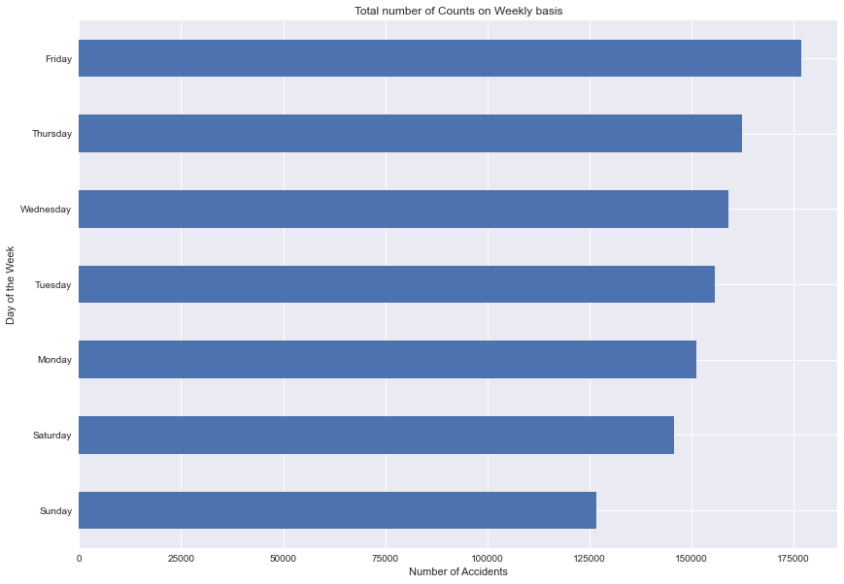
Total count of Accidents on Weekly basis
Highest accidents during Friday, Thursday.
Least during Saturday and Sunday.

Slide 12
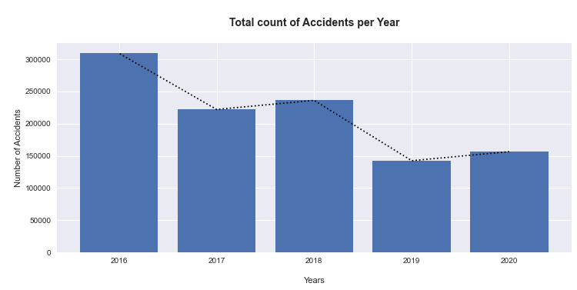
Total Number of Accidents on Yearly basis
Most accidents in 2016
Least in 2019

Slide 13
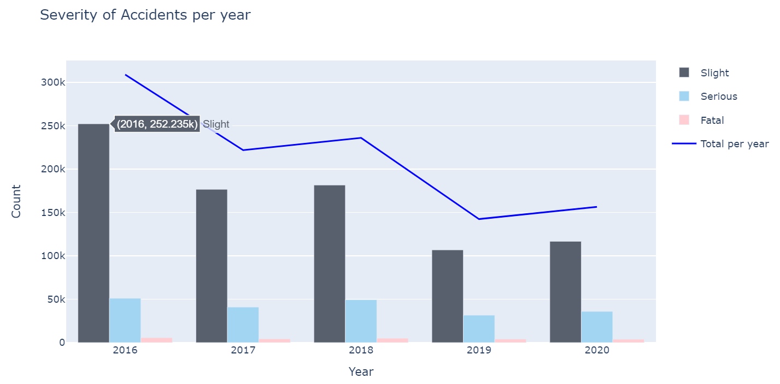
Total count of Severity of Accidents on yearly basis
Mostly Slight accidents occurred
Serious and fatal were constant through out all the years.

Slide 14
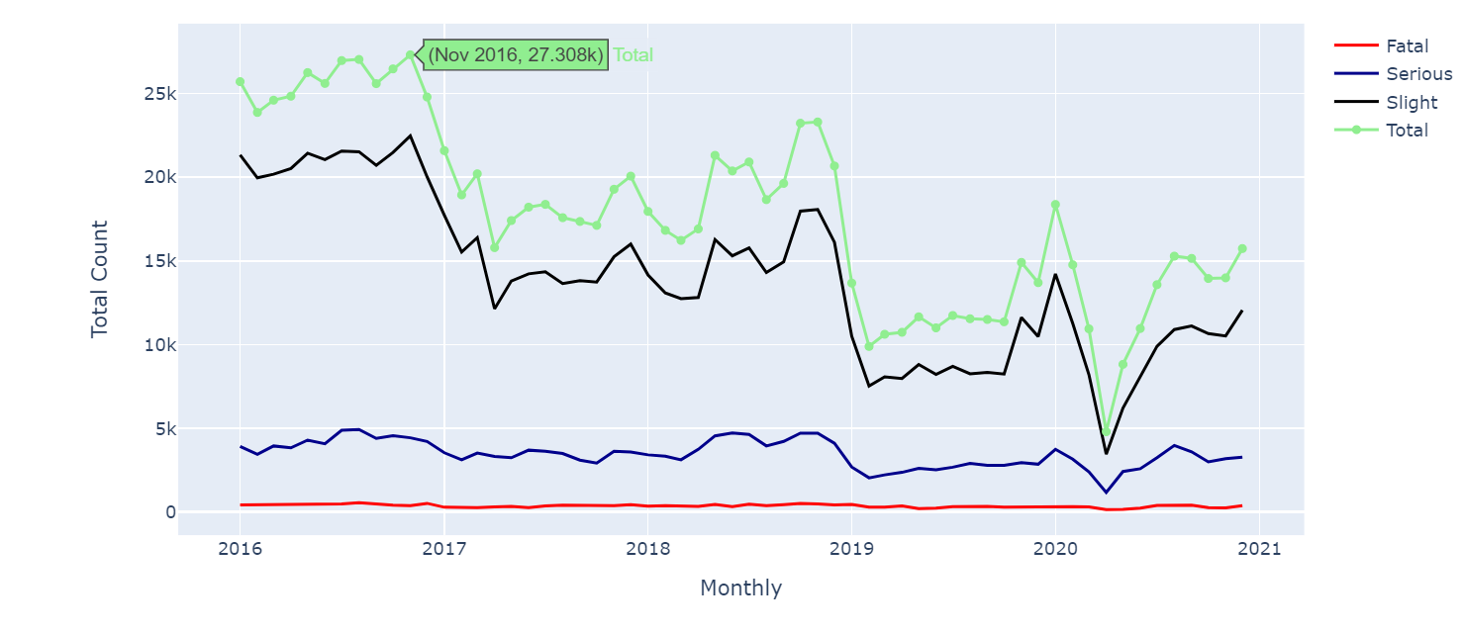
Total accidents that occur Monthly based on Severity
Accidents mostly occurred during the month of October and November throughout all the five years

Slide 15
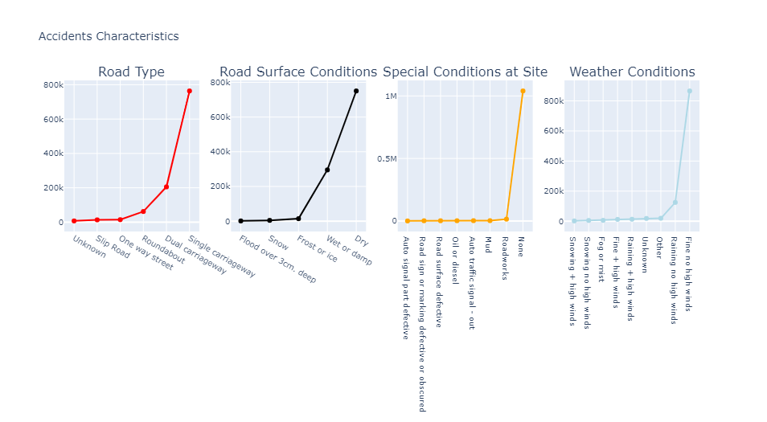
Road and Weather Conditions
Accidents mostly occurred when all the conditions were normal

Slide 16
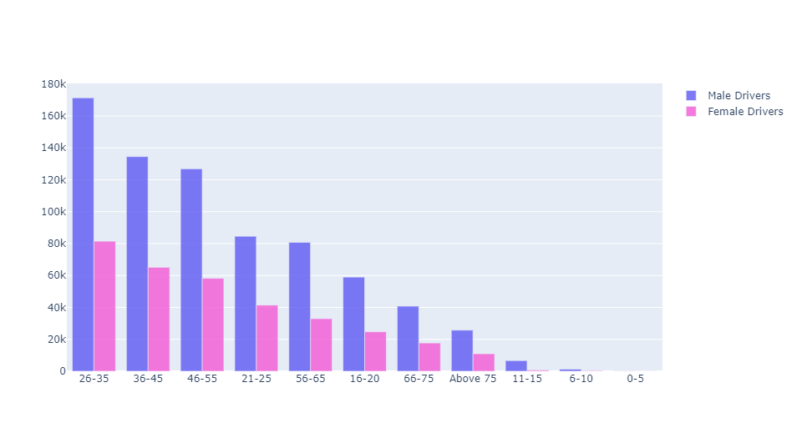
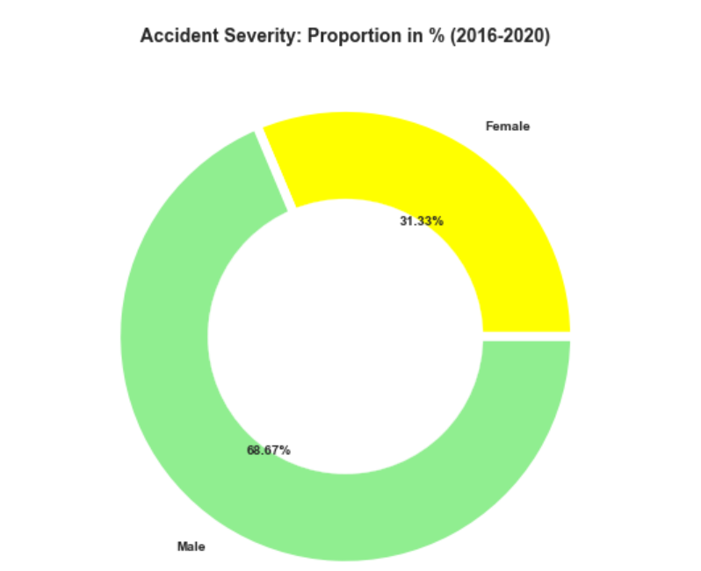
Age and Gender
Male gender were prone to more accidents
Age band from 26-35 were involved in accidents more

Slide 17
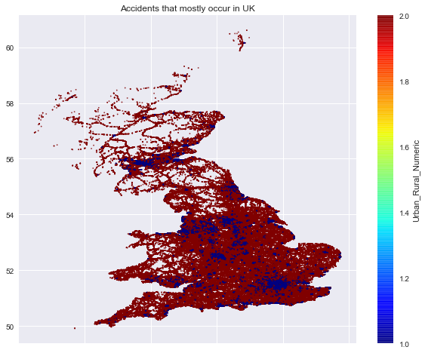
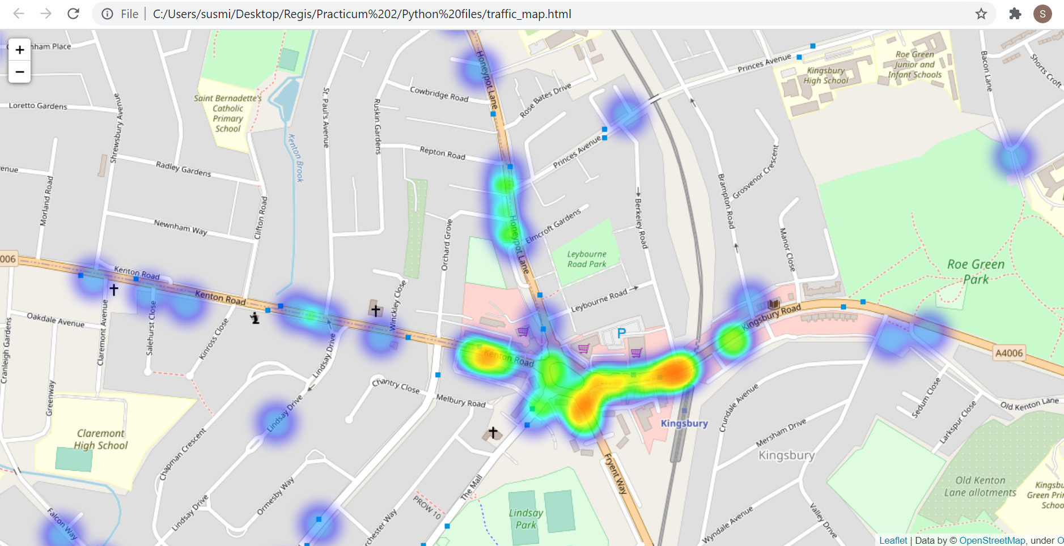
Maps

Slide 18
Machine Learning Algorithms Predicting the Severity of Accidents
Gaussian Naïve Bayes
KNN
Logistic Regression
Decision Tree
Random Forest Tree

Slide 19
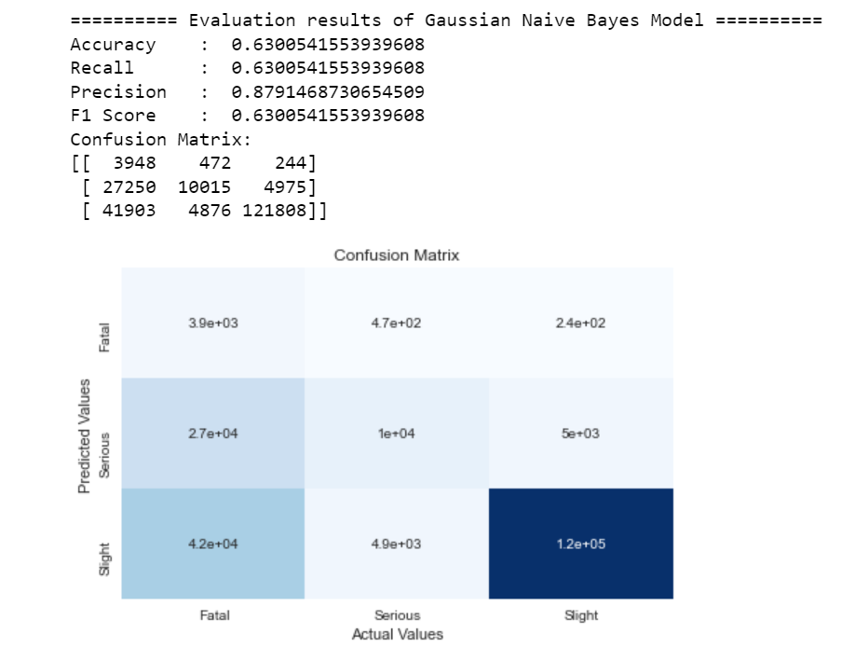
Gaussian Naïve Bayes
Naive Bayes Theorem is a very simple classification that can make strong assumptions on every input variable independence.
Accuracy is 63% and time taken for execution was around 350ms

Slide 20
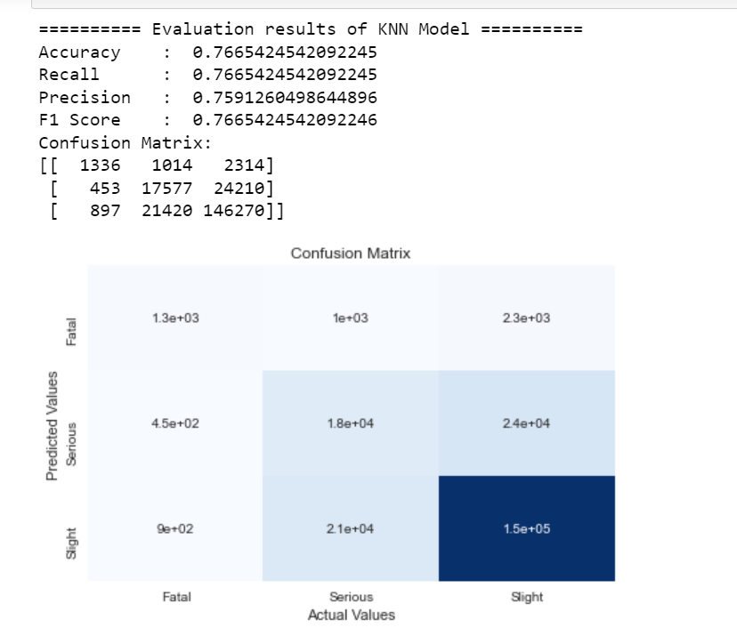
KNN
K-Nearest Neighbors Algorithm is a powerful algorithm to make predictions. Using KNN algorithm by taking 'n_neighbors' with 4 to find out the accuracy
Accuracy was 76% and time taken for execution was in between 35-50mins

Slide 21
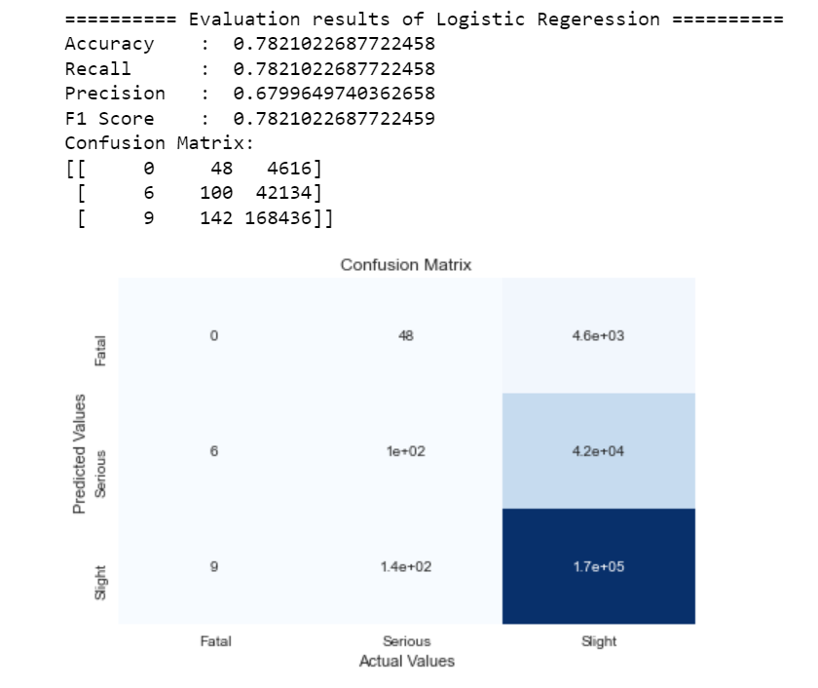
Logistic Regression
Accuracy was 78% and time taken for execution was 38ms

Slide 22
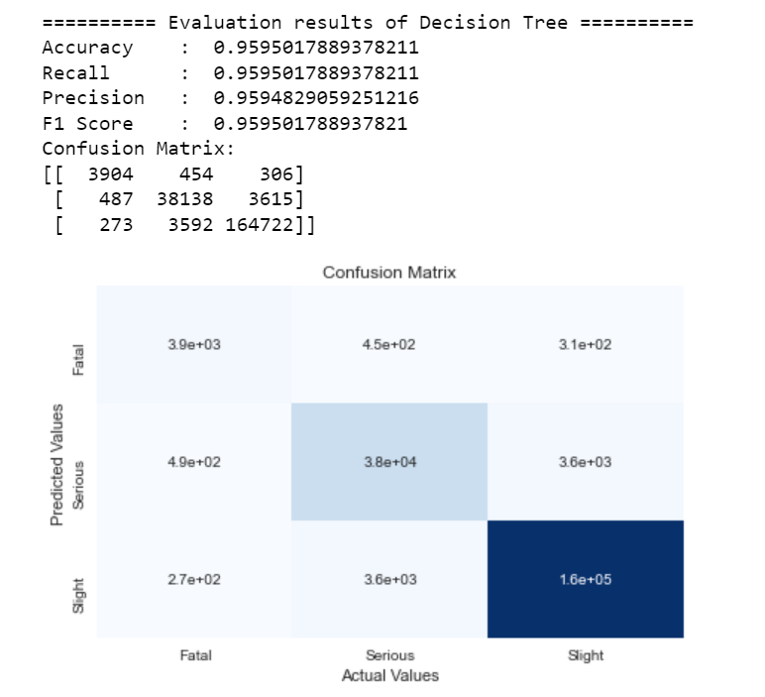
Decision Tree
Decision tree is built on a complete dataset by using all features. It is used when we need our model to be simple.
Accuracy was 95% and time taken for execution was 80ms

Slide 23
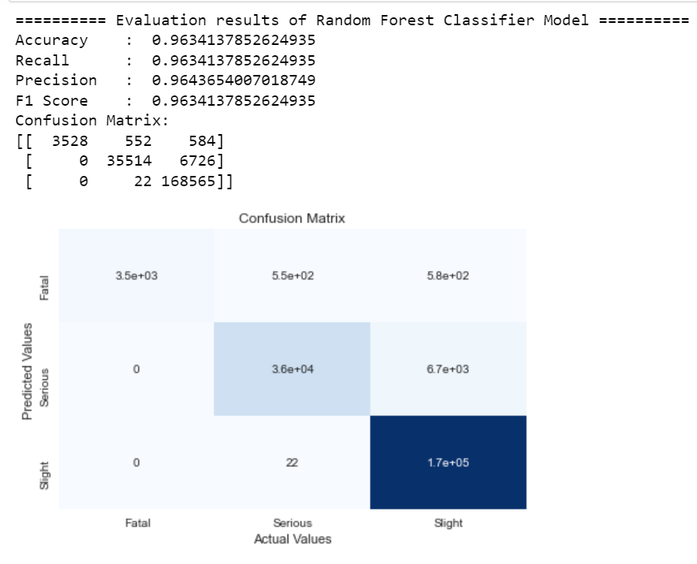
Random Forest
In Random Forest it randomly selects different rows or observations and specific variables or features to get a multiple Decision Tree and then averages the results.
Accuracy was 96% highest among all the models
Time taken for execution was around 10s, which is the least time taken among all the models

Slide 24
Conclusion
Number of accidents and casualties occurred the most during Working hours from 10am to 4pm.
Accidents were more in 2016 but was less in 2019 and 2020. On monthly bases accidents were high during October and November every year.
Severity of accidents were more in Slight, whereas Fatal and Serious were constant and less among all the five years.
Road and Weather conditions did not play important role in occurrence of accidents.
Males were more prone to accidents and age group of 26 to 35 had highest number of accidents.
Accuracy in Predicting the Severity of Accidents was highest by Random Forest Tree classifier with 96% and it has taken the least time for execution which was about 10s. Therefore, best prediction was given by Random Forest Classifier.

Slide 25
GitHub Link
https://github.com/Susmitha1594/Accidents-in-UK

Slide 26
Thank you!!!

